Slide 1

Rating Prediction & Recommedation Analysis for Restaurants on
Zhao Chen, Jiaying Wu & Chen Li

Slide 2
Project Outline
1. Objective
2. Data ETL & EDA
3. Methods and Findings
Regression: Lasso, RandomForest, Xgboost, and Neural Network
Recommender System: SVD, Content filtering
Sentiment analysis: NLP
4. Conclusions

Slide 3
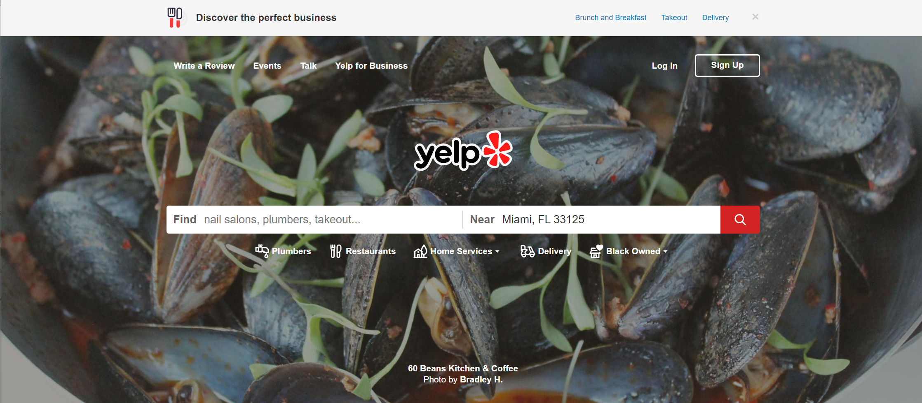
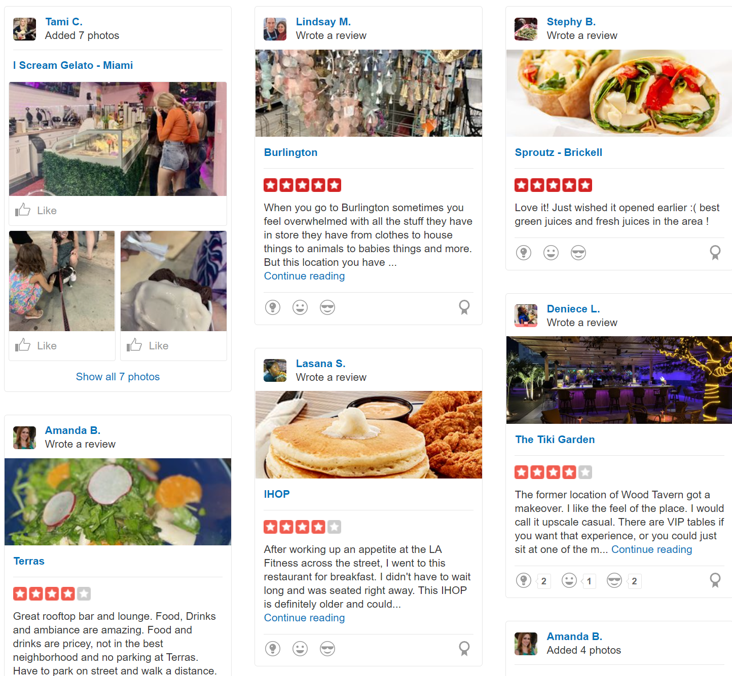
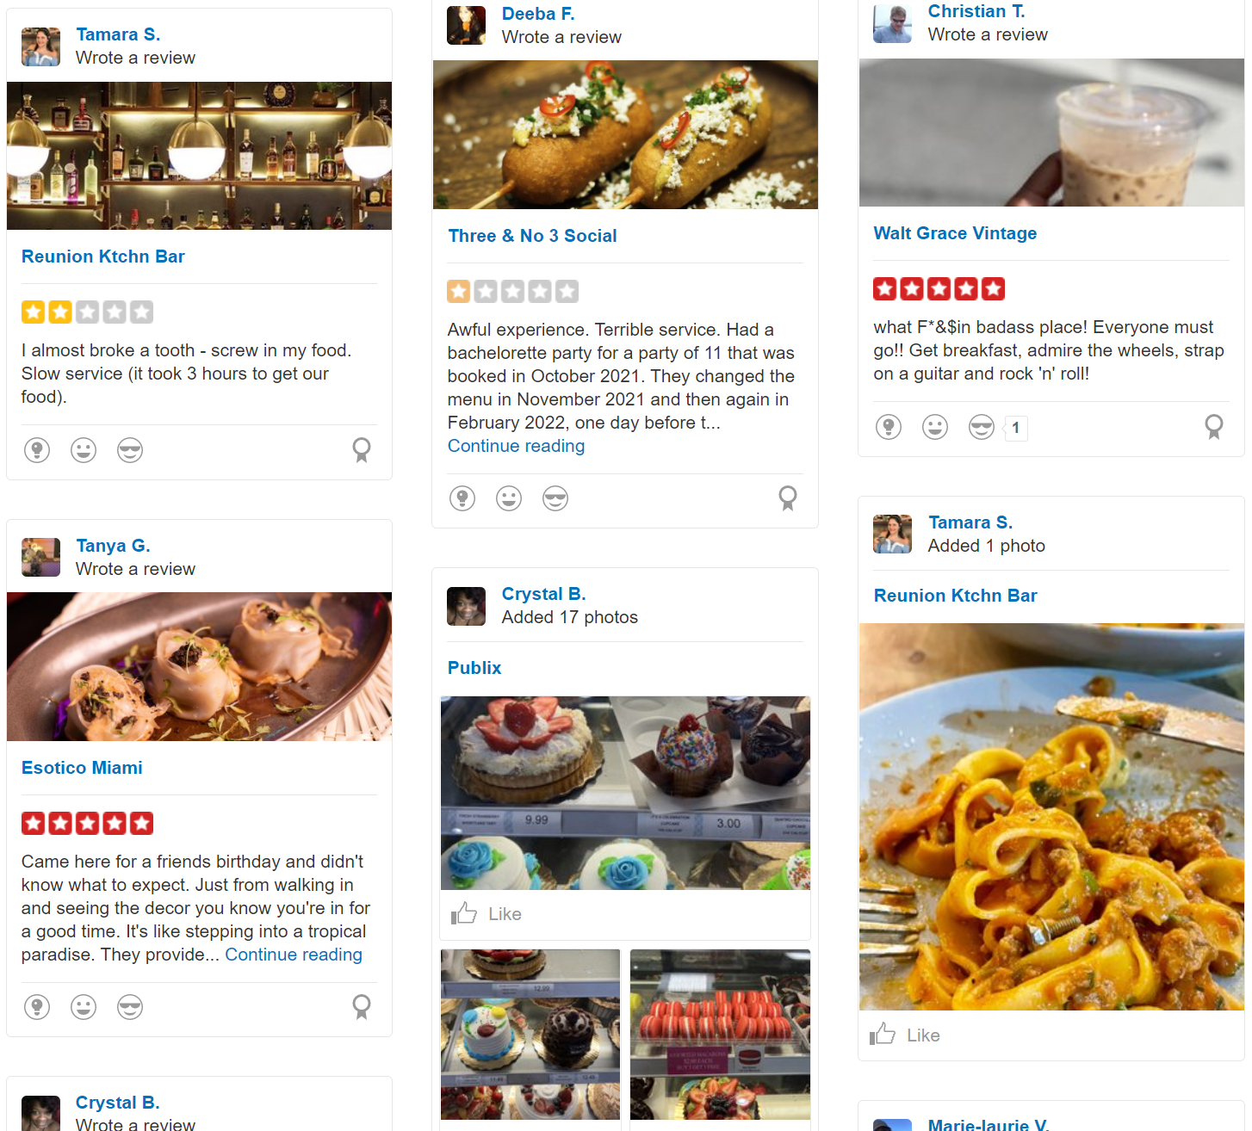
Objective
Identify the best model to predict restaurant ratings and test the recommendation

Slide 4
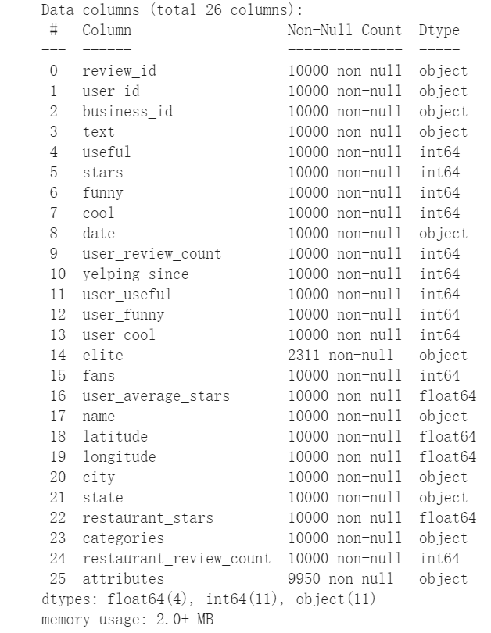
Data ETL
Extract
Yelp Open Source Dataset
https://www.yelp.com/dataset/documentation/main
10 GB JSON file to CSV
Extract from 3 datasets: business, user, review
Select restaurants that are open
Filter date ranging between 2020 and 2021
26 columns
Randomly extracted 10000 observations
Transform
Load
Merge 3 datasets into one as csv format
Uploaded to GitHub

Slide 5
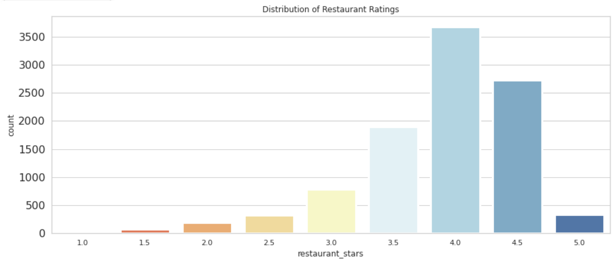
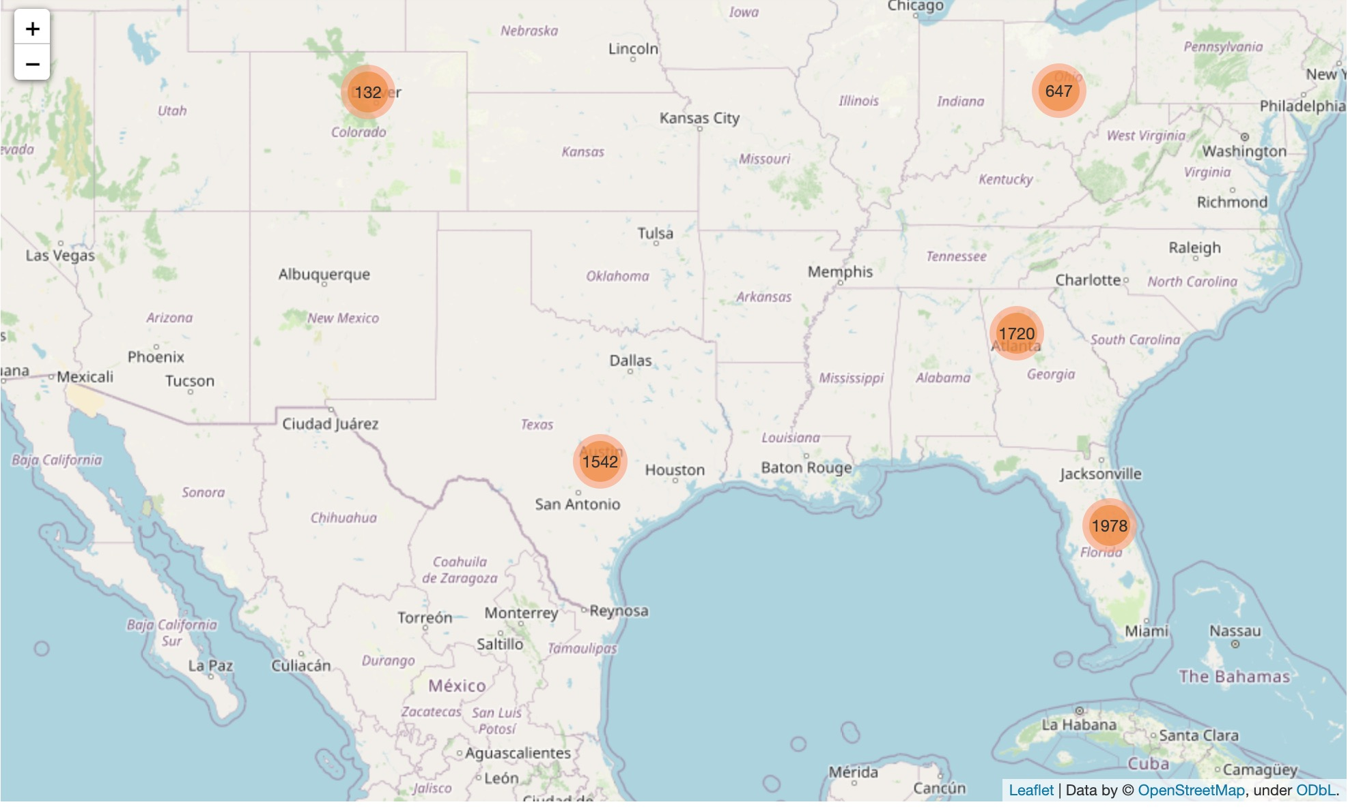
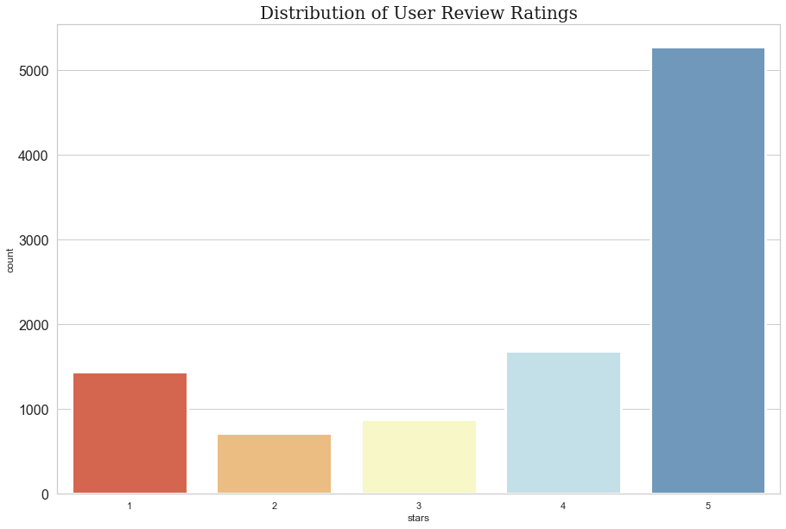
Data EDA (Exploratory Data Analysis)
Rating distributions
Restaurant locations
Average Ratings of the Restuarants
Average Ratings of the Users’ Review

Slide 6
Methods
We tested multiple models to predict rating data
Predictor Dataset
Lasso, RandomForest, Xgboost
Neural Network
12 predictors
(e.g., user_review_count, fans)
Regression Analysis
3 predictors
(user_id, business_id, stars)
Recommender System
SVD,
Content-based
Models
2 predictors
(name, text)
NLP (natural language processing)
Sentiment Analysis
1 column
(text data)

Slide 7
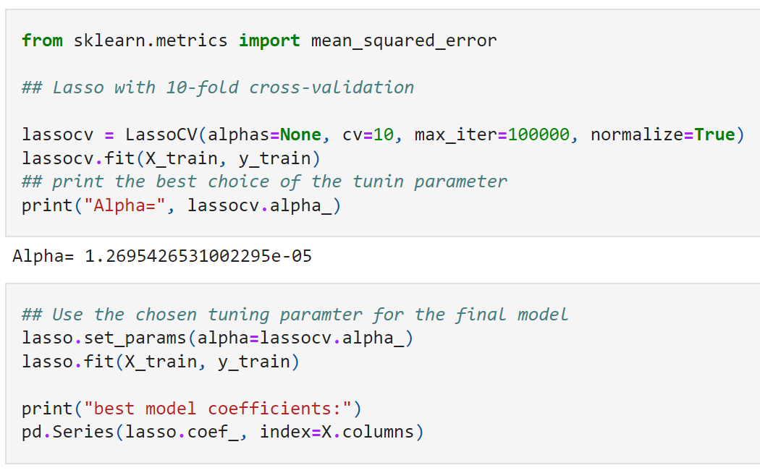
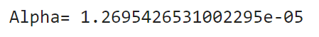
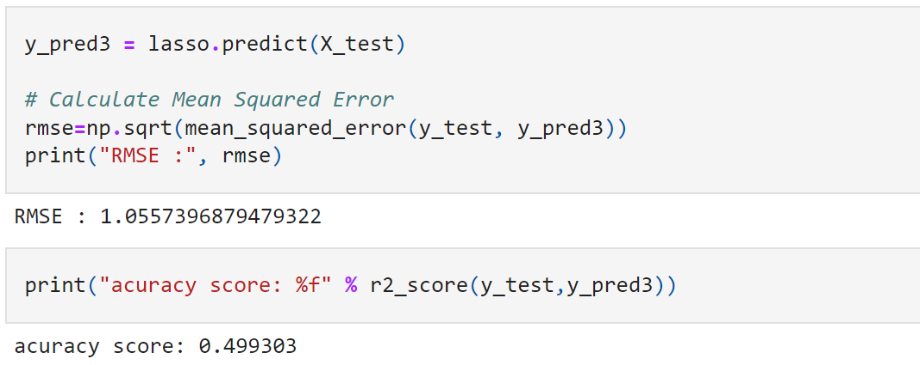
Lasso
Regression Analysis
Findings
Notable high error
Fit bad
RMSE: 1.056
Accuracy score (R²): 0.499

Slide 8
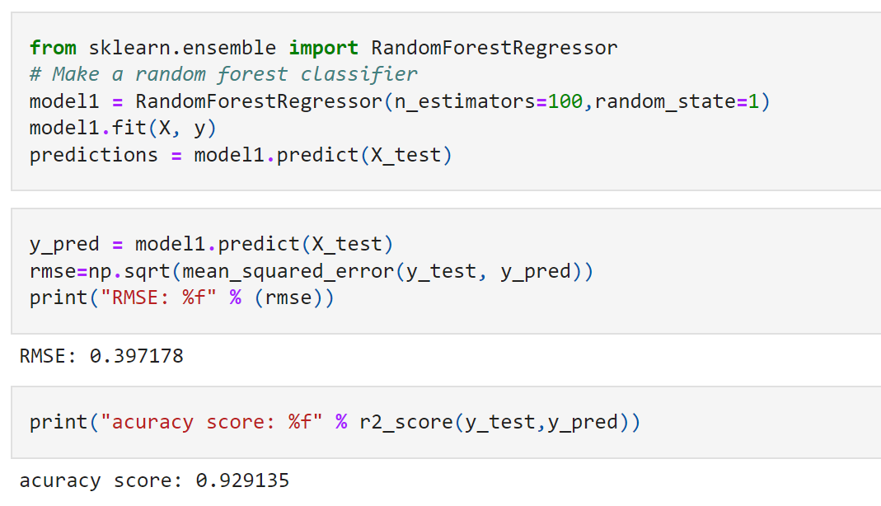
RandomForest (RF)
Regression Analysis
Findings
Low error
Fit well
RMSE: 0.397
Accuracy score (R²): 0.929

Slide 9
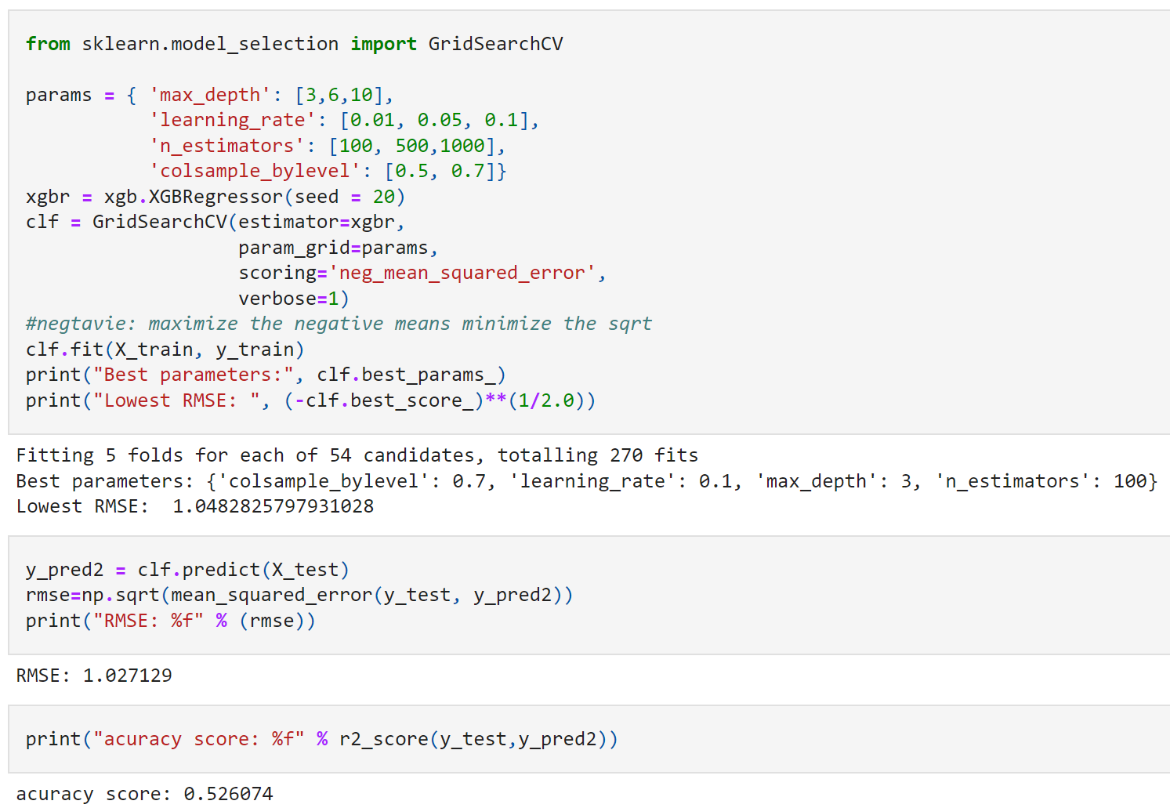
Xgboost
Regression Analysis
Findings
High error
Fit bad
RMSE: 1.027
Accuracy score (R²): 0.526

Slide 10
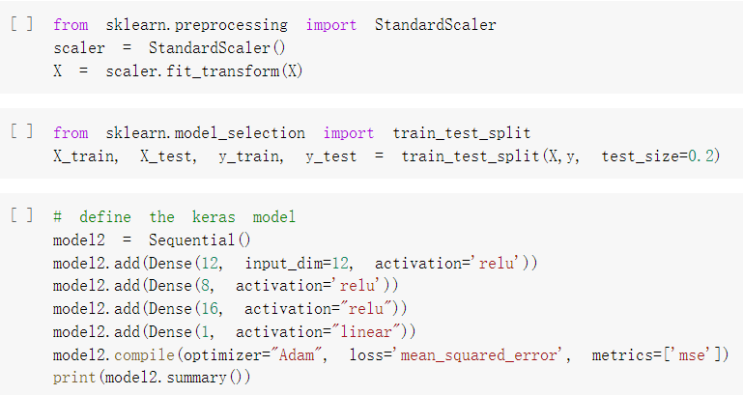
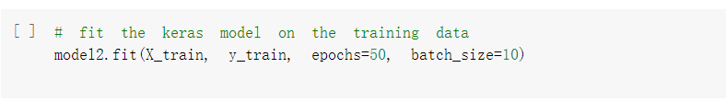
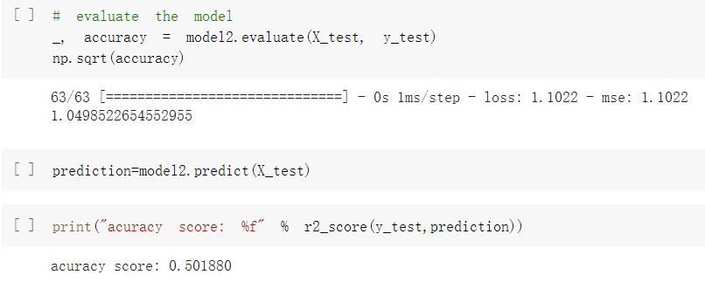
Neural Network
Regression Analysis
Findings
High error
Fit bad
RMSE: 1.050
Accuracy score (R²): 0.502

Slide 11
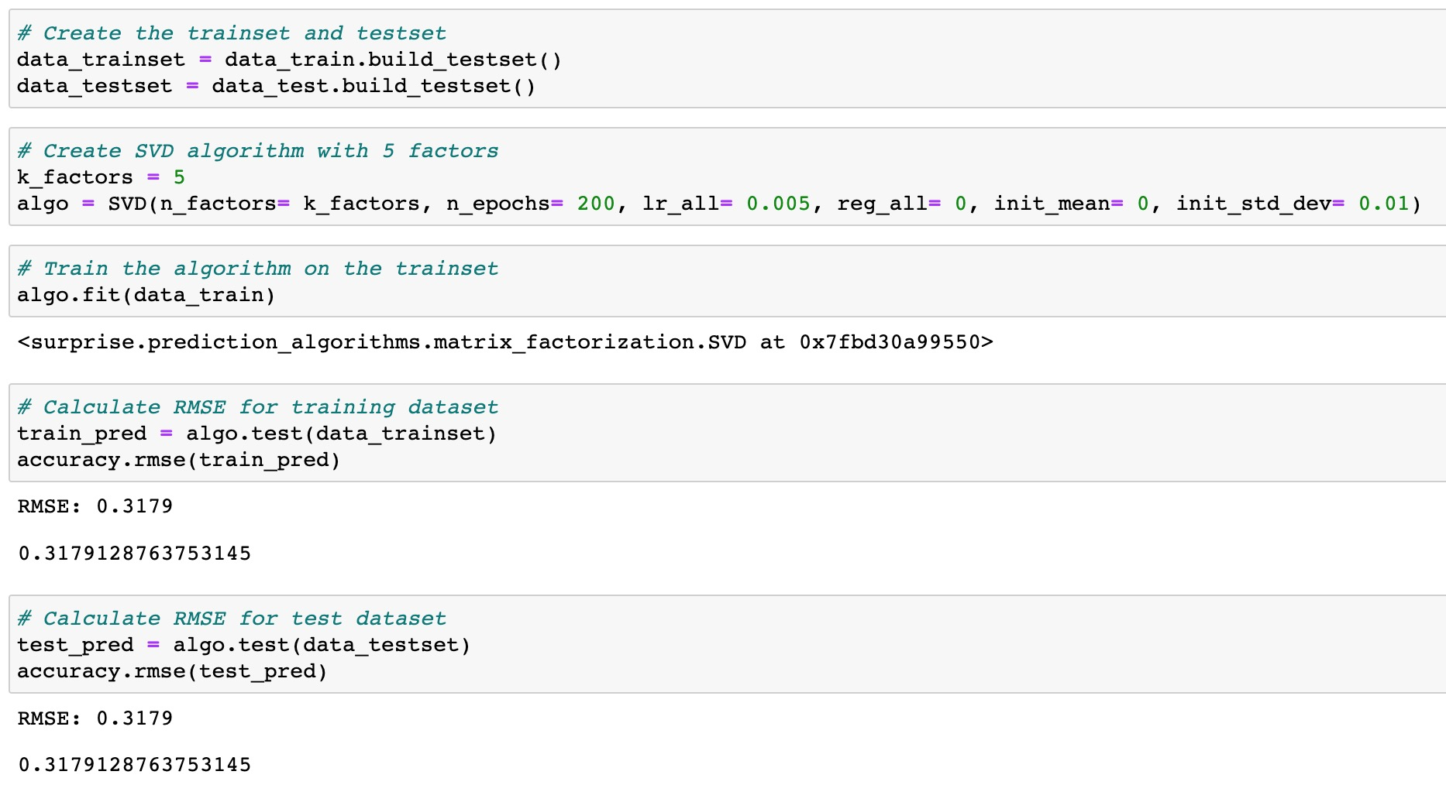
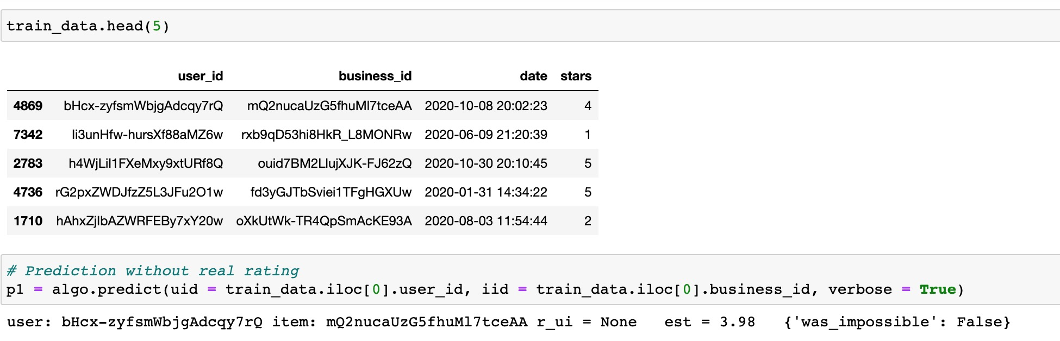
SVD (Collaborative filtering)
Recommender System
Findings
The error is the lowest
RMSE: 0.318
E.g., the prediction of rating (3.98) vs the observation of 4

Slide 12
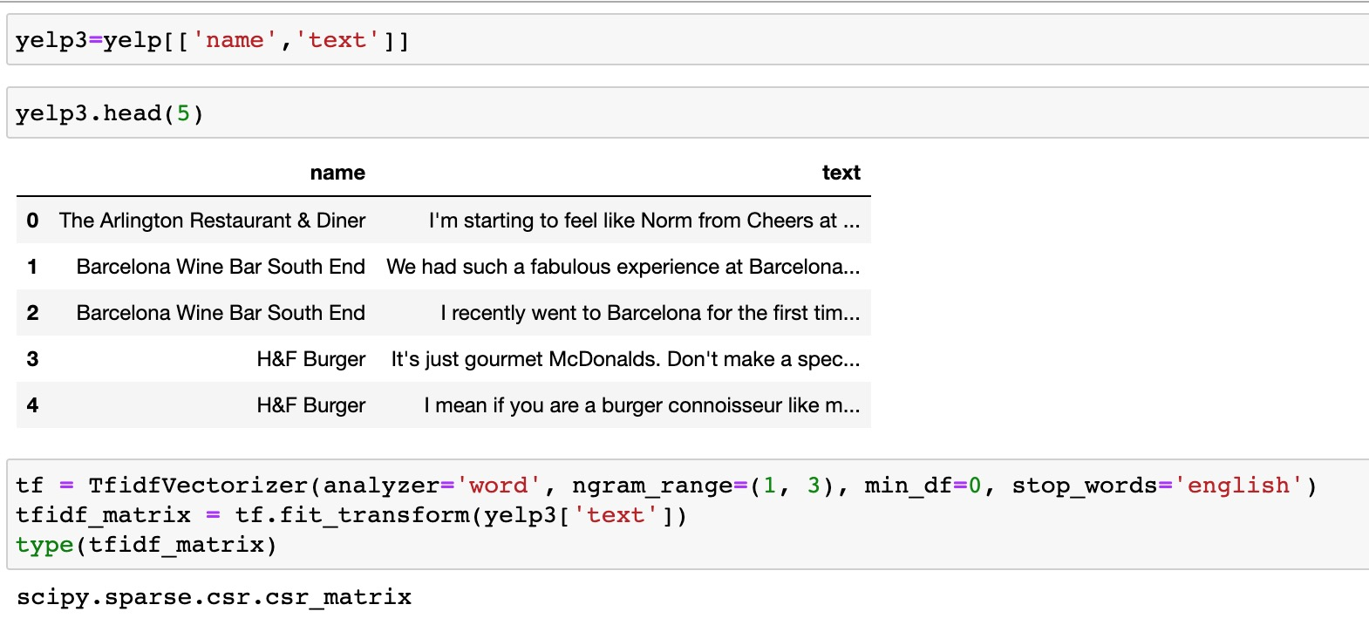
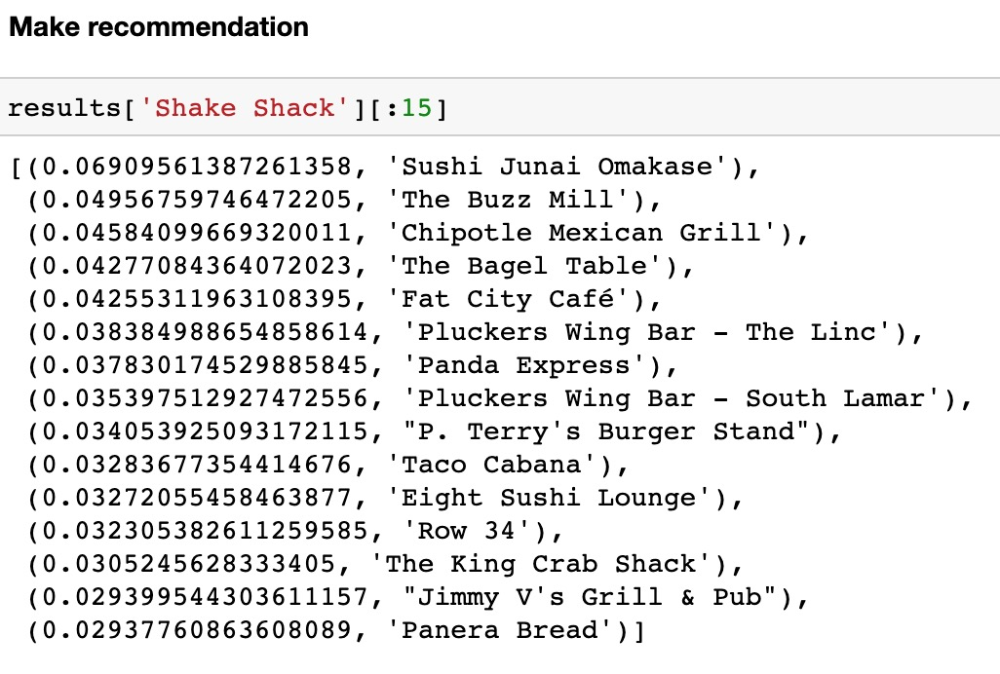
Content-based Recommender
Recommender System
Findings
We only used 2 predictors
Cosine similarities is applied
The recommendations match up with our intuition

Slide 13
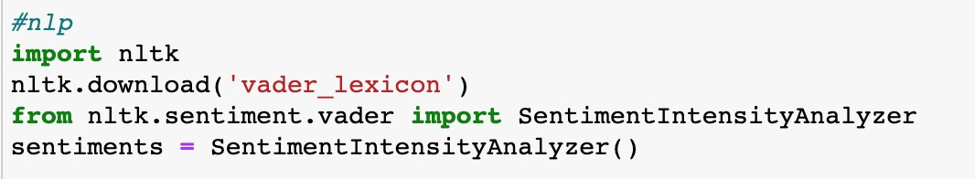
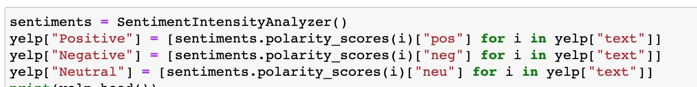
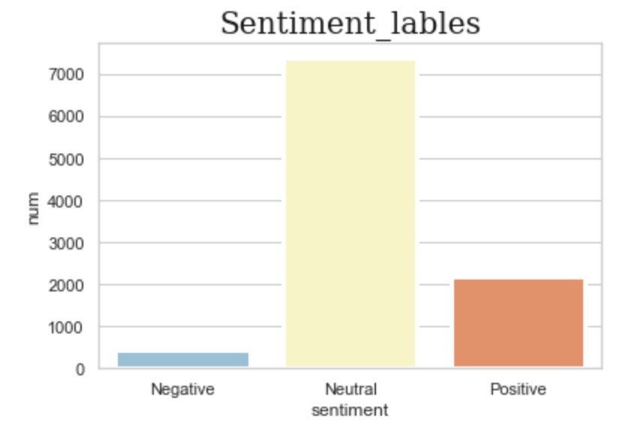
NLP (Natural Language Processing)
Sentiment Analysis
Findings
NLP sentiment analysis is a black box
# of neutral reviews are the highest
The results does not reflect the observed ratings

Slide 14
RMSE/ R² Score Comparison
Models | Regression Analysis |  |  |  | Recommender System |  | Sentiment Analysis
 | RF | Xgboost | Lasso | Neural Network | SVD | Content-filter | NLP
RMSE | 0.39 | 1.03 | 1.06 | 1.05 | 0.32 | -- | --
Accuracy Score (R²) | 0.93 | 0.53 | 0.50 | 0.50 | -- | -- | --
Notes:
The performance of the models applied in this project is compared using RMSE or R2 and the results are shown in this table. SVD has the lowest RMSE, indicating it has the best fit and good performance in predicting ratings when information of predictors are given. The models using Content-filter and NLP produced text-based results, and its performance can not be assessed using RMSE.

Slide 15
Conclusions
Under the category of regression analysis, the Random Forest model using 12 predictors performs the best (RMSE=0.39) when predict ratings.
Under the category of recommender system analysis, SVD model based on the collaborative filtering method using 3 predictors shows an even improved performance (RMSE=0.32).
The content-filtering based model produced recommendations that well match up with our intuition.
Sentiment analysis using NLP shows a very different results compared to the true observation of the rating distribution.

Slide 16
Business Insights
If we wish to predict the potential ratings from a customer for a specific restaurant when predictor information is given, the Random Forest model and SVD model could work well.
If we have the descriptions of the restaurants, we could use the content-filtering-based model to offer suggestion for customers who look for similar favorite restaurants.
For the NLP model, its results may not be proper to be used in restaurant recommendation. Further investigation of this method is needed.

Slide 17
Thank you!

